Slide 1
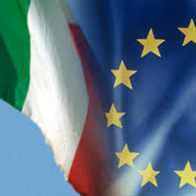
ITALY IN EUROPEAN UNION
ADVANTAGES AND DISADVANTAGES OF BEEN PART OF U.E.

Slide 2
Introduction
Italy is one of the six founders of the European Community.
It was, in the beginning, called European Coal and Steel Community, and it was created by signing a Treaty signed in Paris on 18 April 1951 by Belgium, Germany, France, Italy, Luxembourg and the Netherlands. The aim of the Treaty, was to contribute, through the common market for coal and steel, to economic expansion, growth of employment and a rising standard of living.
European Communities (EC) (1967)
Denmark, Ireland and the United Kingdom joined in 1973
Greece in 1981
Spain and Portugal in 1986
European Union (EU) (after 1992) (Maastricht Treaty)
Austria, Finland and Sweden in 1995
Largest enlargement took place with 10 new countries joining May 9, 2004

Slide 3
Advantages of beeing in E.U.
1. Low prices of goods – there exists a ‘Single Market’ for all member countries wherein products are low-priced and there are no charges when it comes to custom tax; custom tax is usually charged when goods are transported or sold between states/countries but this is not applied among member countries

Slide 4
Advantages of beeing in E.U.
2. Citizens are free to move from one member country to another . Citizens can freely travel, study, work, or live in any European country of their choice

Slide 5
Advantages of beeing in E.U.
3. More jobs are generated – more or less than 3.5 million jobs have been generated over the years

Slide 6
Advantages of beeing in E.U.
4. Development of deprived regions – some member countries of the EU are economically deprived and through the ‘European Structural Funds’, deprived regions are developed

Slide 7
Advantages of beeing in E.U.
5. Louder voice – the EU is able to ensure that all their concerns are taken seriously and heard internationally since it speaks in behalf of millions of people

Slide 8
Advantages of beeing in E.U.
6. Workers are protected – this is made possible through the European Working Time Directive; the directive includes regulations regarding holidays, working hours, breaks, etc.

Slide 9
Disadvantages of beeing in E.U.
1. It is costly to be a member of the EU. Italy in 2014 spent 134 billion euro

Slide 10
Disadvantages of beeing in E.U.
2. Not all policies are efficient – a good example is that of the Common agricultural Policy which resulted to oversupply and higher prices of goods

Slide 11
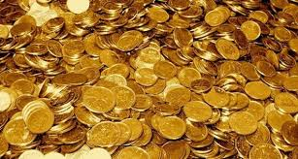
Disadvantages of beeing in E.U.
3. The ‘single currency’ poses a great problem – not all member countries are using the Euro though the EU emphasized its use; still, many problems have risen over the years

Slide 12
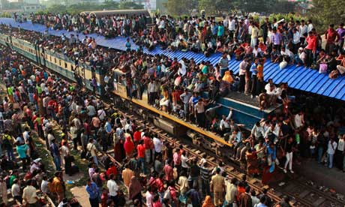
Disadvantages of beeing in E.U.
4. Overcrowding –the citizens of member countries are free to move from one place to another; this has led to overcrowding some cities (for example London)

Slide 13
More about P.A.C.
Italy, specially in the South and in the Islands (Sardinia and Sicily) is a rural Country. The impact of P.A.C., for Italy is still problematic. These are the main problems:
Price and market support has been uneven It favored especially the products of continental crops (Cereals and arable, Milk, beef and pork) in contrast to the Mediterranean cultures, which while representing 25% of EU agricultural production, they receive only 12% of total expenditure. This characteristic that has remained a constant in Pac caused disparities in favor of regions and companies most affected the continental production
Despite the adoption of a policy of supporting prices, farm incomes do not increase satisfactorily. Farm incomes remained low due to the increase of the higher prices of major inputs. The farm incomes did not increase in comparison with those of other sectors

Slide 14
More about P.A.C.
Italy has received fewer benefits, even though its contribution to the overall agriculture budget is about 20%, it receives less than 11% of total expenditure for price support
France while still providing a contribution of slightly above that of Italy (20.6%) receives nearly 25% of the costs
Germany with a contribution of 13% receive funding for more than 15.5%

Slide 15
More about P.A.C.
At the level of individual producers the distribution of benefits of the CAP has been more skewed (Commission estimates)
80% of all contributions went to the 20% of European farms
Another important element of the CAP redistributive concerns consumers the high agricultural prices have encouraged farmers larger and more efficient
at the same time this has led consumer prices higher penalizing consumers with lower incomes who spend a larger share of their income on food

