Slide 1
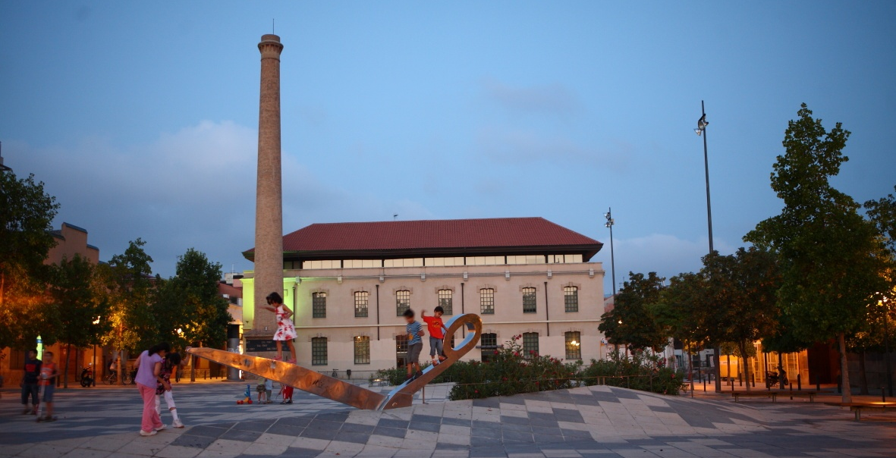
MUNICIPAL E-SERVICES AND THEIR ROLE IN GLOBALIZATION

Slide 2
A GLOBAL E-SERVICES PROJECT: “EASIER AND FASTER”
MAIN GOALS
Improve relations with our citizens.
24 hours, 365 days open online.
Cultural change in provision of public services. Efficiency, quality and continuous improvement.

Slide 3
A GLOBAL E-SERVICES PROJECT: “EASIER AND FASTER”
MAIN RELATED PROJECTS
New Citizen Office. Improving the citizen care.
New Corporate website.
New Online document procedures website.

Slide 4
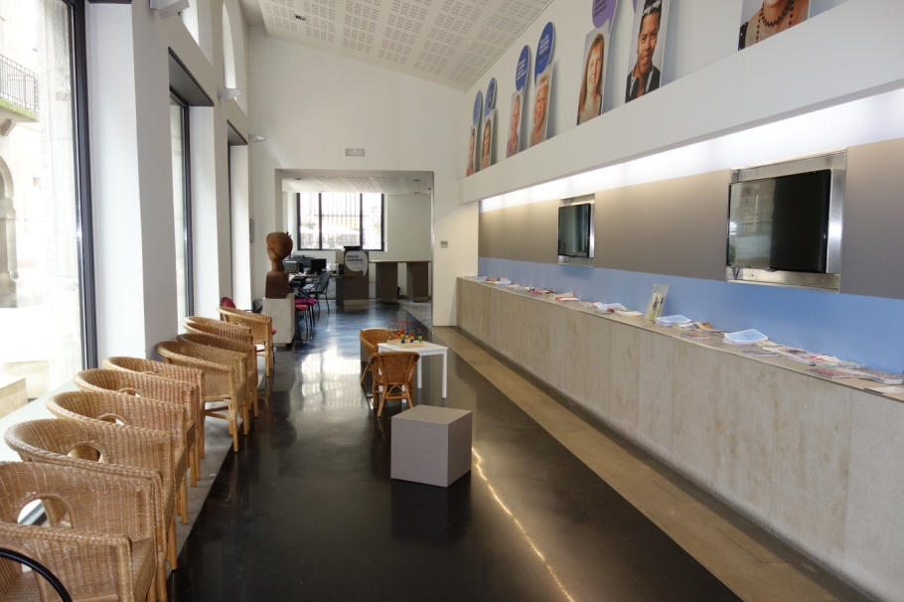
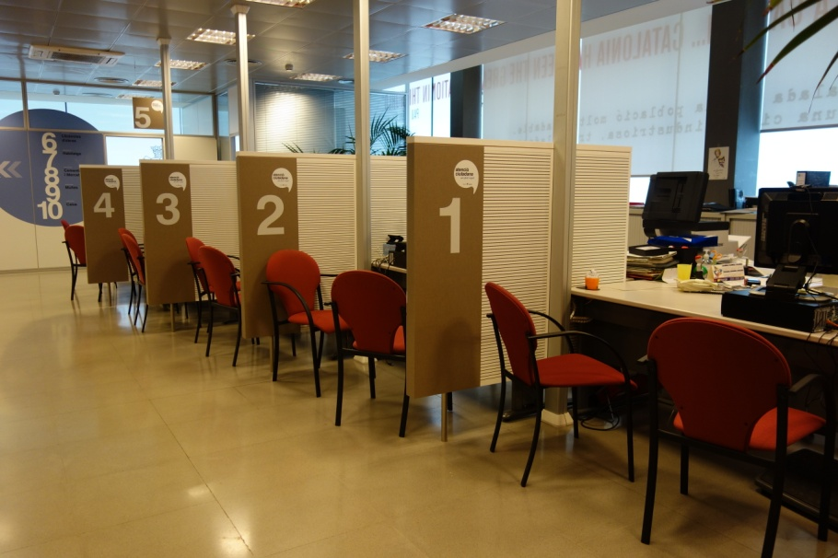
THE CITIZEN OFFICE “easier and faster”
Started in january 2014.
Specialized citizen care, bringing all frontline services together in one specific area on the ground floor.

Slide 5
MAIN GOALS:
Centralization of citizen care.
Increased opening times over the previous system.
Reduce the average waiting time to less than 10 minutes.
Free up back office resources to improve internal paperwork, optimizing employees and processes.
Improve relations with our citizens offering better and handy services.

Slide 6
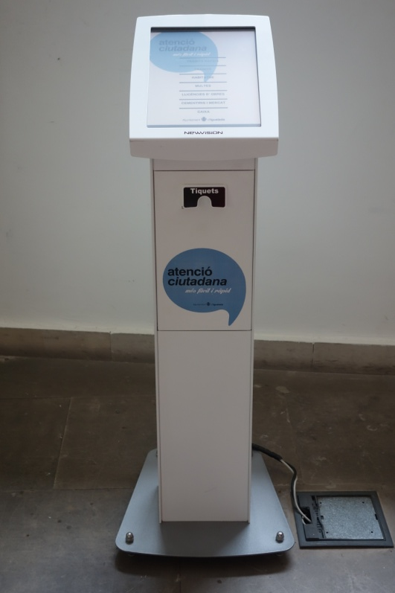
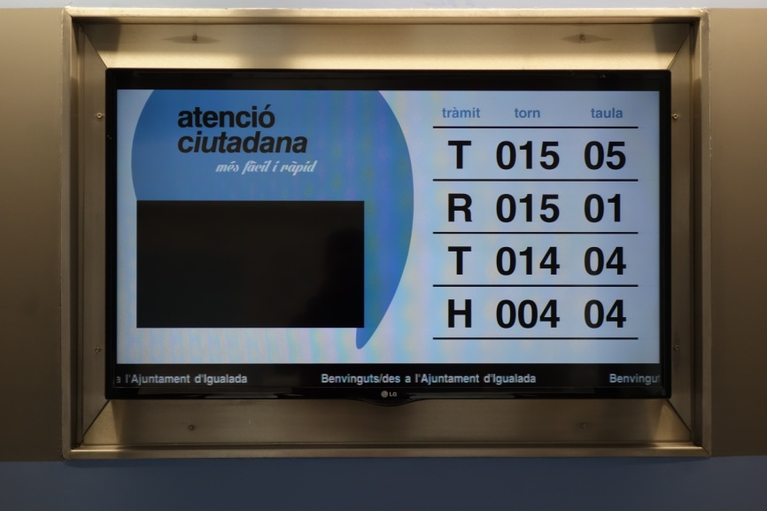
THE CITIZEN OFFICE “easier and faster”
Implementation of a Queuing Managing System (QMS) allows us to manage and measure visits, to offer the best possible customer experience.
It is possible to book an appointment by phone or online.
“we have removed the phisical queue!”

Slide 7
THE CITIZEN OFFICE “easier and faster”
FACTS:
A total of 33.300 visitors used the services of the citizen office last year.
The average citizen waiting time remained 80% below ten minutes in most cases.
The results of customer satisfaction surveys are highly satisfactory (89% total satisfaction on average).

Slide 8
NEW CORPORATE WEBSITE
Started in october 2014.
Is the official information source of the municipality, linked to state e-government platforms and own document procedures website.
Responsive, multi device and browser-independent design, for maximum users compatibility.
Collaborative content management: all departments participate in the content creation.
http://www.igualada.cat

Slide 9
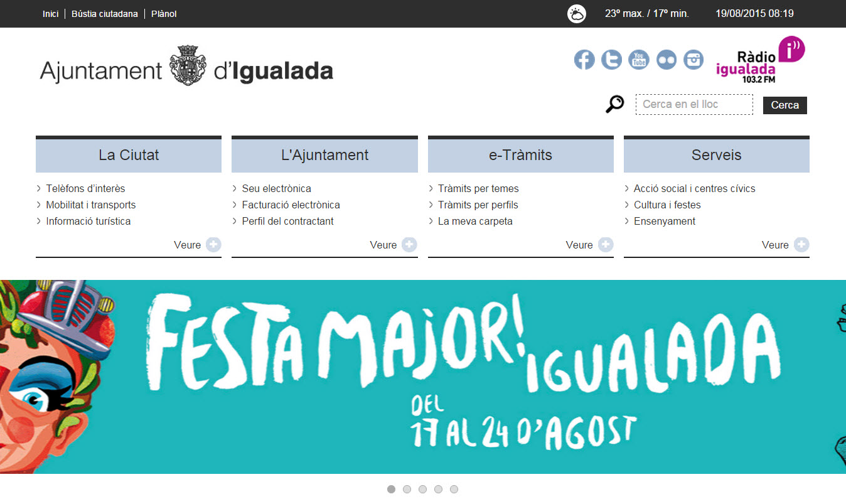
NEW CORPORATE WEBSITE
MAIN AREA: access to general city information: tourism, public buildings, official information and links to catalog services and document procedures website.

Slide 10
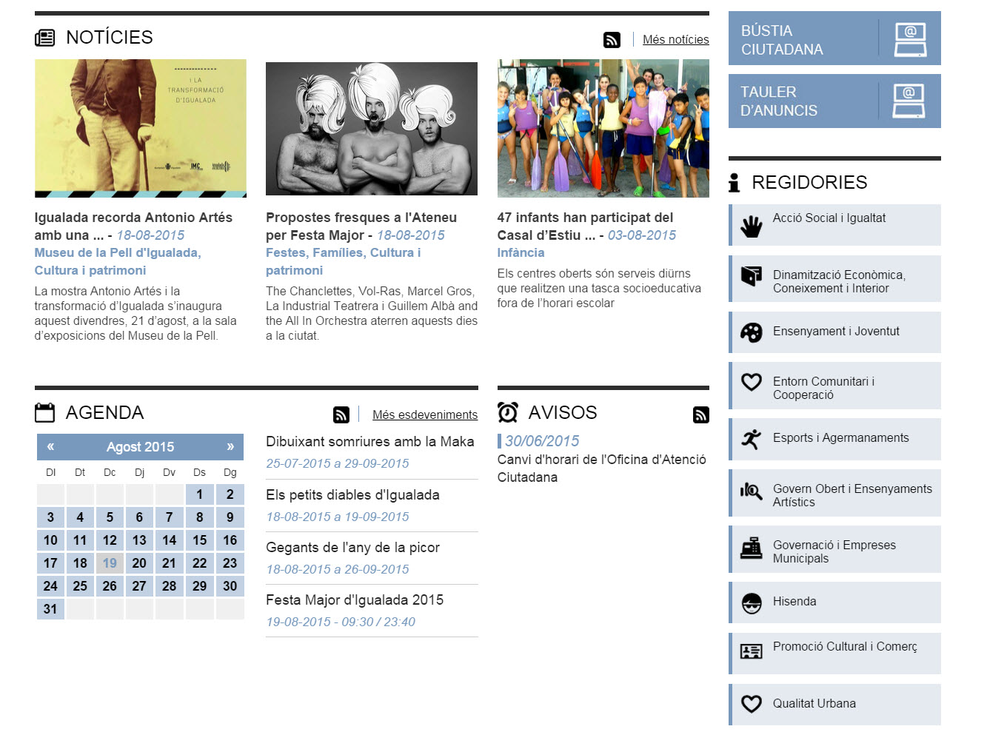
NEW CORPORATE WEBSITE
THEMATIC AREAS: access to news list, alerts and schedule of city events. Also, general information about departments.

Slide 11
NEW CORPORATE WEBSITE
THEMATIC AREAS: featured items, links to the most used document procedures, Mayor’s web space and classification by user profiles.

Slide 12
NEW CORPORATE WEBSITE
FACTS:
More than 160.000 sessions in 10 months.
91.000 different users visited our website.
30 % of the visits made with mobile devices.
Most visited pages: cultural event information, tourist information, news and schedule, catalog of services…
http://www.igualada.cat

Slide 13
NEW ONLINE DOCUMENT PROCEDURES WEBSITE
It contains all procedures that can be done with us.
Used by the majority of municipal employees in their everyday tasks.
Three diferent visions: user/citizen, employees, administrators: the same platform for all.
100% cloud-based and integrated with other municipal information systems.
Easy to maintain and update, available 24h/365d.
https://www.tramits.igualada.cat

Slide 14
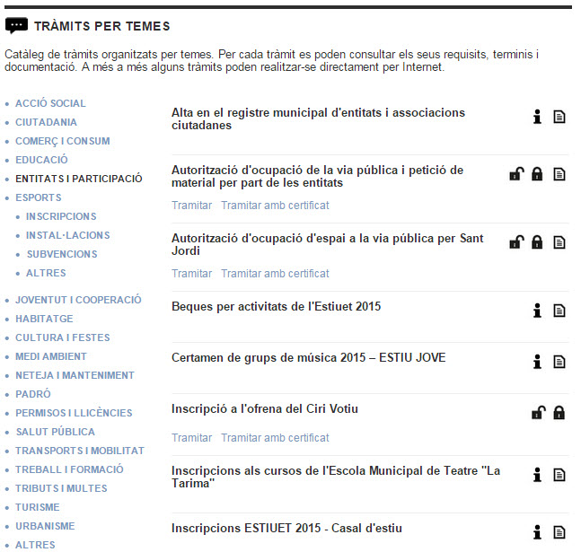
NEW ONLINE DOCUMENT PROCEDURES WEBSITE
The user has all the proceedings classified according to subjects of interest

Slide 15
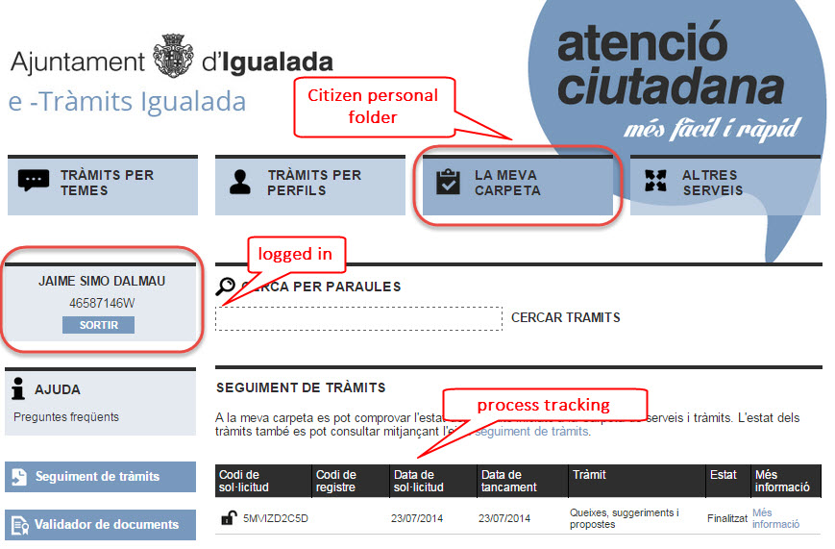
NEW ONLINE DOCUMENT PROCEDURES WEBSITE

Slide 16
NEW ONLINE DOCUMENT PROCEDURES WEBSITE
Back Office employees
Corporate
Information
Systems
Data & Application servers
Department 1
Department "N"
Citizen Office
External host
Attention point 1
http://www.igualada.cat
https://www.tramits.igualada.cat
Attention point "N"
At home Citizen
Tablet/Smartphone user
Business

