Slide 1
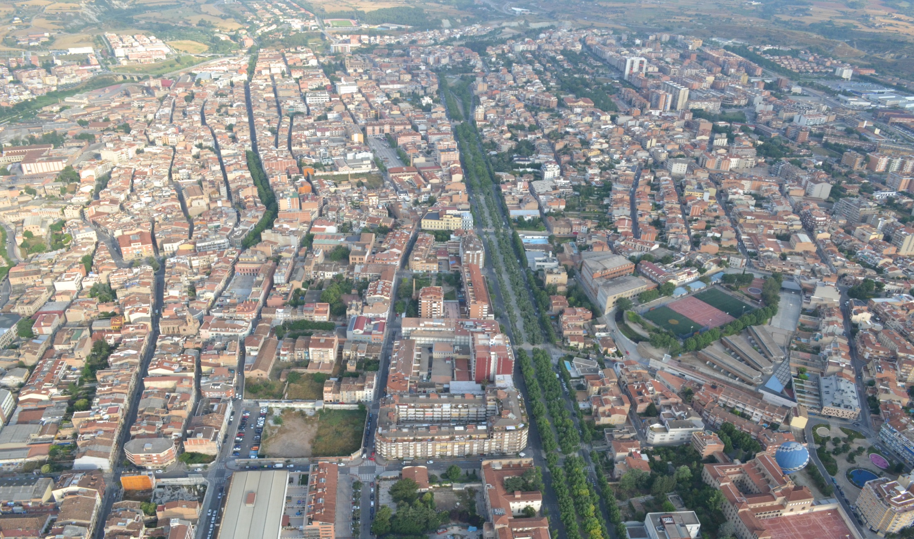
PROJECTS FUNDED BY EU FUNDS

Slide 2
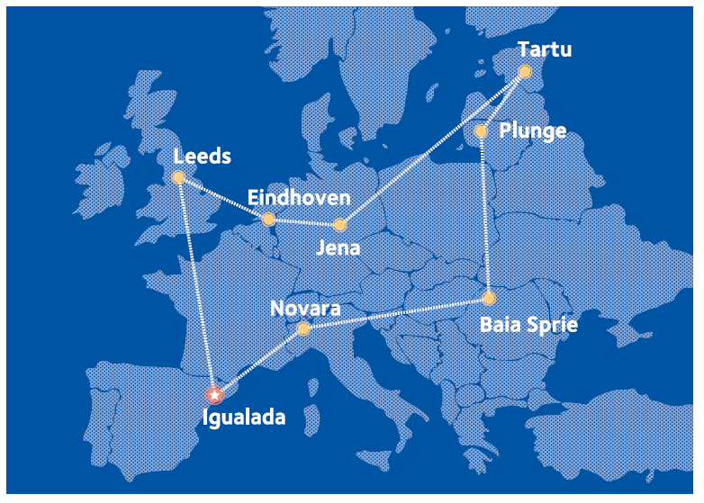
TRANSNATIONAL COOPERATION PROGRAMME - URBACT
4D Cities project (2012-2015): in the framework of URBACT II, a transnational cooperation programme.
Network: 8 European cities
The project aimed at
fostering the Innovation
in Health to promote the
local economic growth
and social development.

Slide 3
At transnational level: Exchanging experiences and practices in the field of innovation in health.
At local level: each city work with their local stakeholders (health system, companies, knowledge institutions and citizens) in its particular project.
Igualada focused the project on preventing the hip fracture.

Slide 4
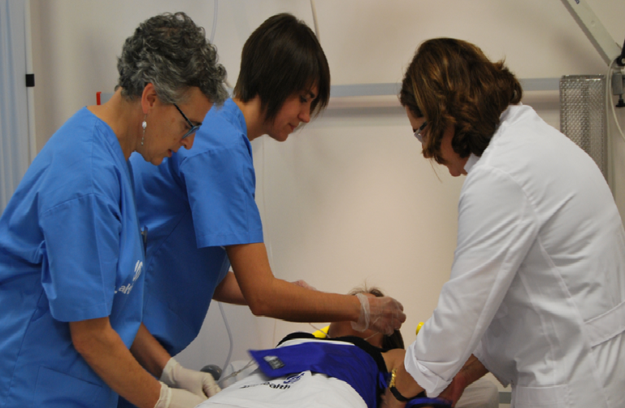
PROJECTS FUNDED BY ERDF FUNDS
4D HEALTH INNOVATION SIMULATION CENTRE
ERDF Funds: 750,000 €
Simulated hospital that recreates the whole health environment.
To train health professionals to reduce the number of health errors by using simulation.
It reuses the former Igualada
Hospital so it is based on a real
hospital >> costs savings and
efficiency.

Slide 5
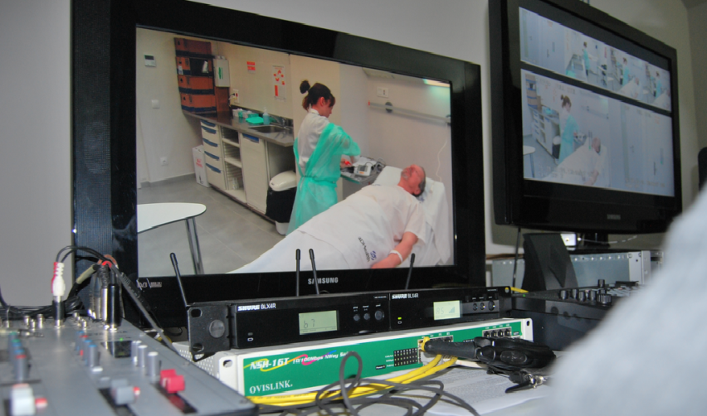
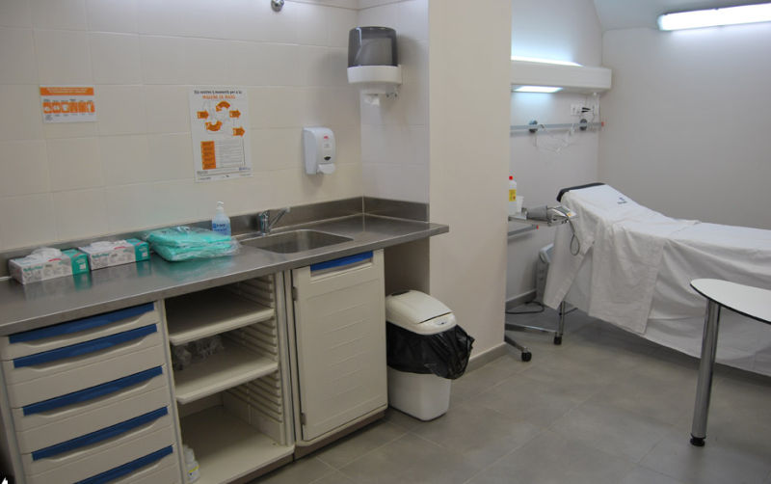
Addressed to:
Health professionals to increase their transversal skills
Companies to test their products before being commercialized >> test their usability
Universities, health schools, research centres to design new plans, processes and applications.
Patients, associations of patients and their relatives are given information, training, support and accompaniment.

Slide 6
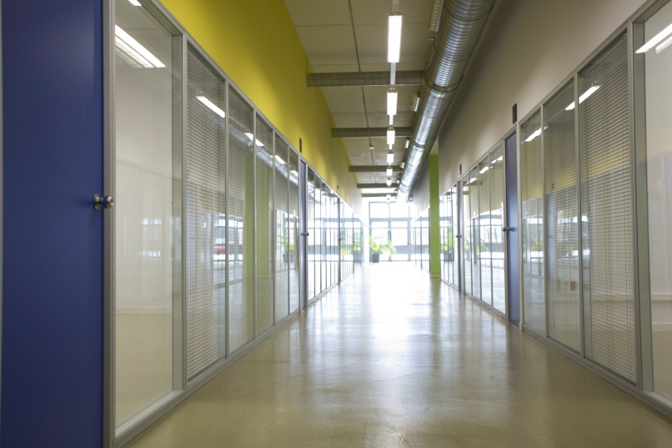
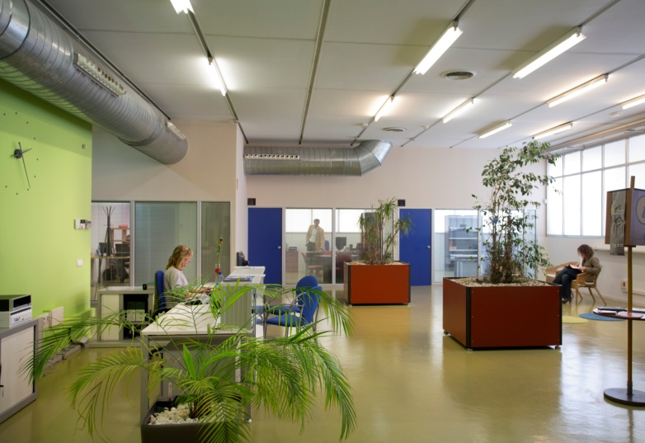
BUSINESS INCUBATOR – TECNOESPAI
ERDF Funds: 264,700 €
Business incubator to support entrepreneurs to start up their companies (ICT and environmental companies).
Advantages: offices at lower prices, training, counselling, networking.

Slide 7
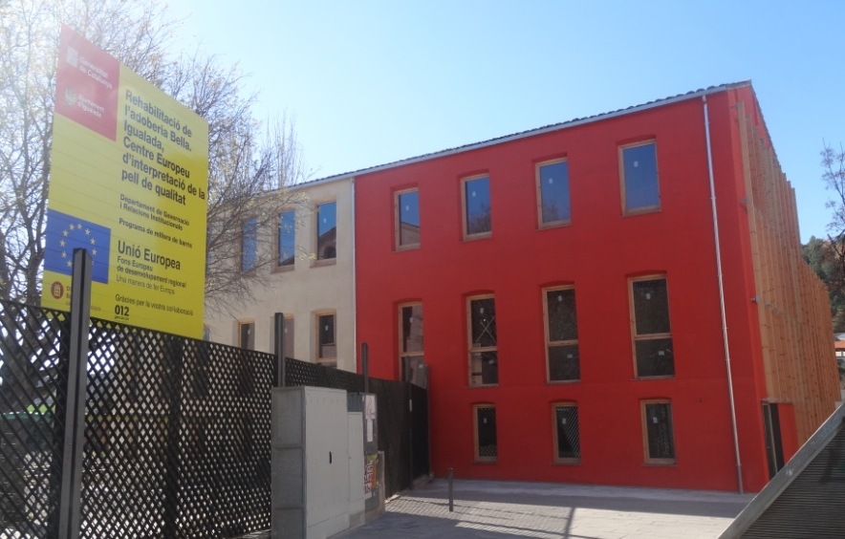
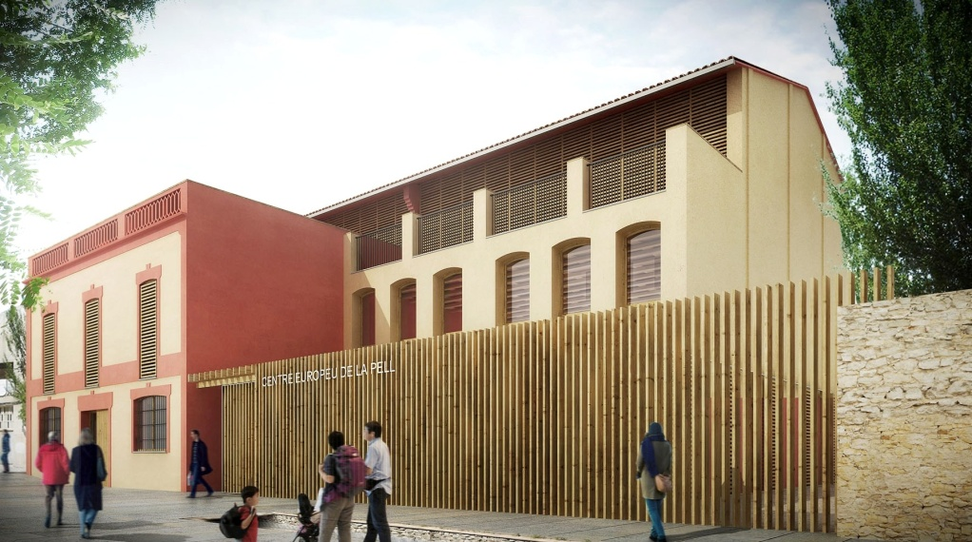
ADOBERIA BELLA
ERDF Funds: 375,000 €
Restoration of an old tannery to become the headquarter of the European Capital of Quality Leather.
Meeting rooms, showroom, etc. It will also be the “guide” for the restoration of the headquarters of the tannery area.

Slide 8
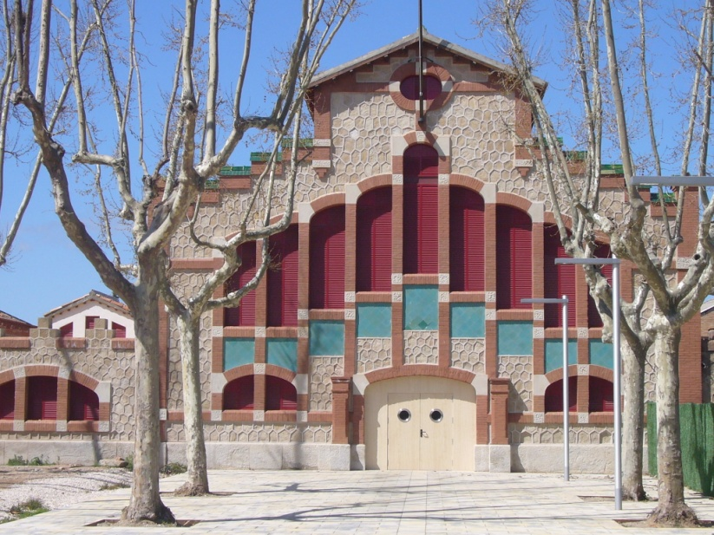
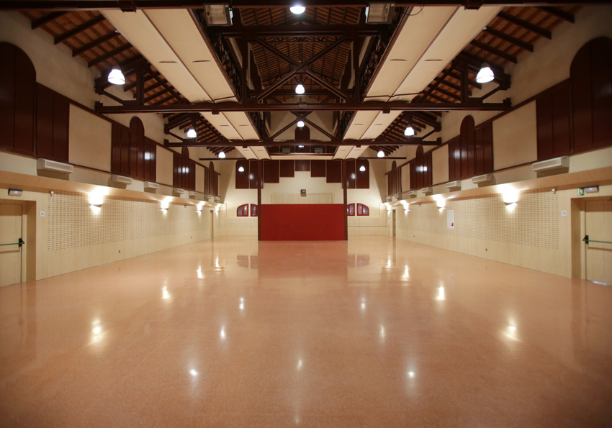
ESCORXADOR – THE SLAUGTHERHOUSE
ERDF Funds: 200,000 €
Restoration of the old slaughterhouse
Uses: cultural events, expositions, fairs

