Slide 1
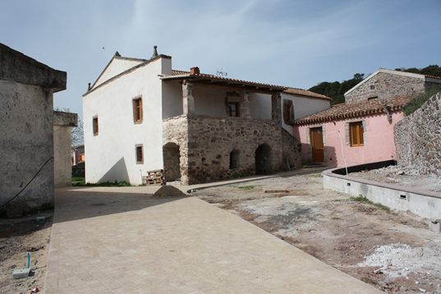
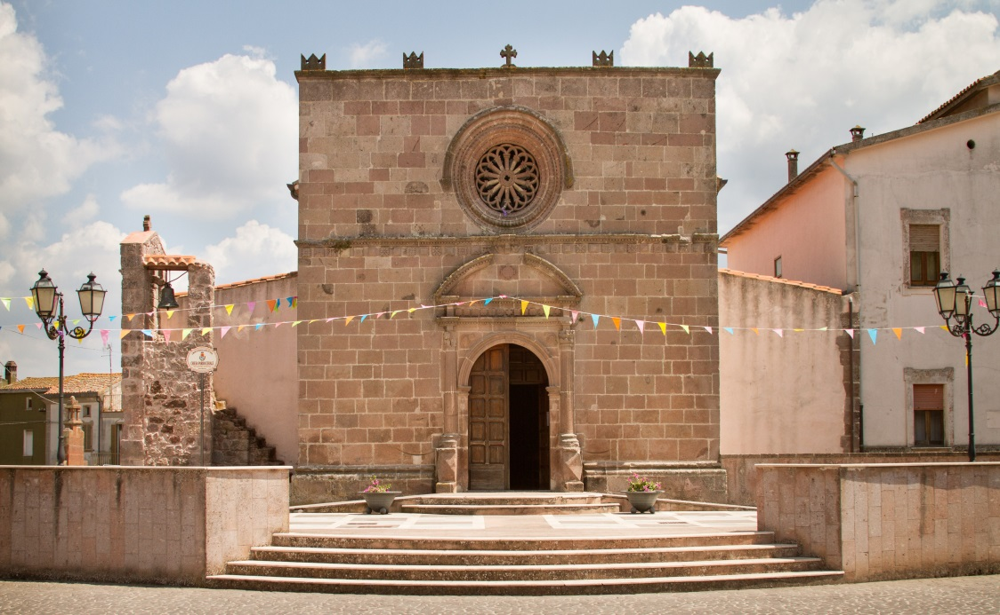
Youth Policy
A small town in the middle of Sardinia:
Youth Policy, in a town of about 500 inhabitants, take its origin by knowing every single youngster.
That means to focus youth policy of the municipality on real necessities.

Slide 2
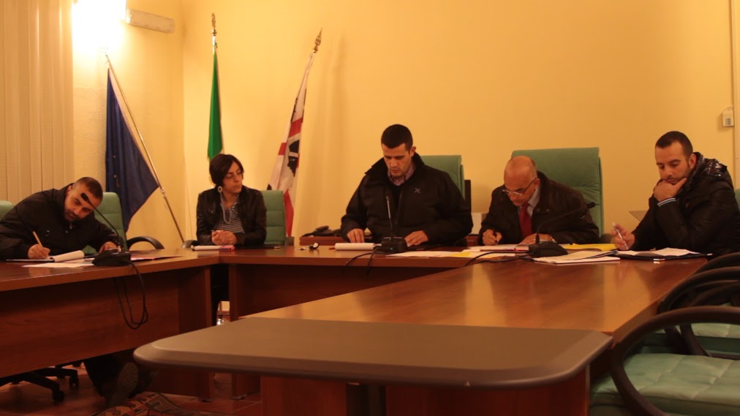
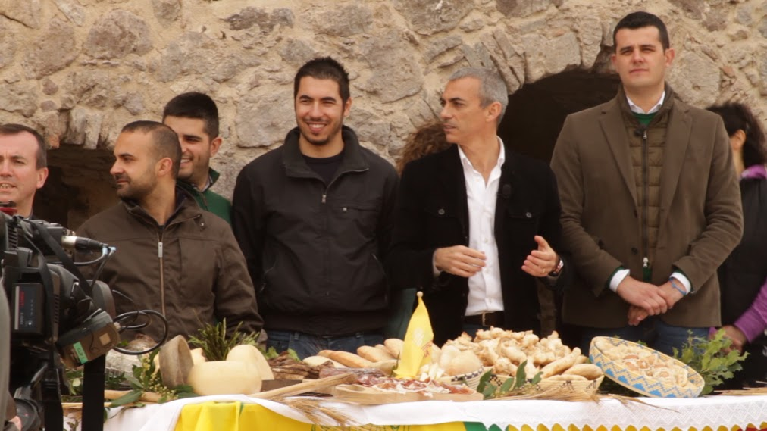
Youth Policy
The first youth policy action:
The Political project
It was called Future Nughedu and it is an innovative political project aiming at rejuvenate the administration of the town.
At the time of the election the average age of councilors was 29.
The project takes its idea from the fact that new generation is the most prepared and intelligent, but they don’t know how to use this strength.

Slide 3
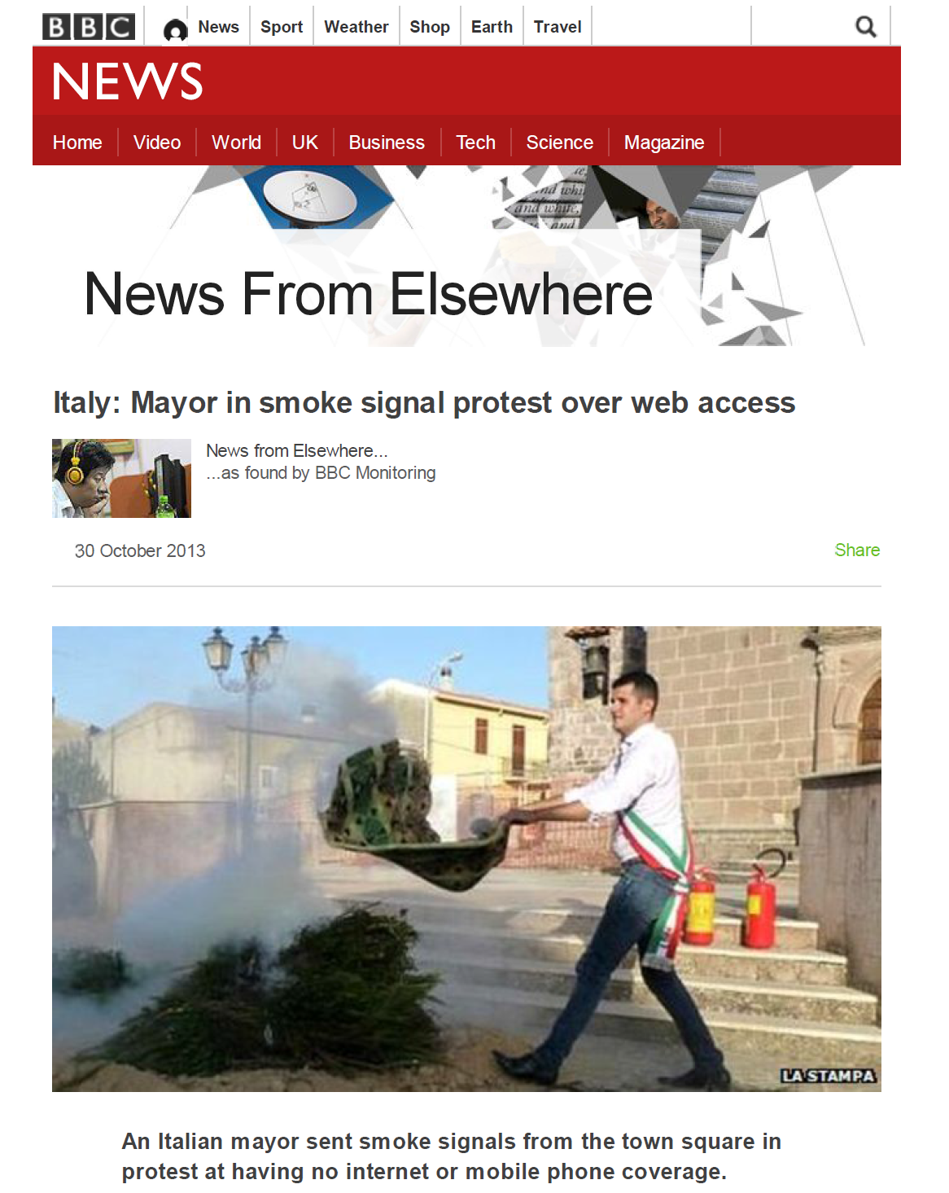
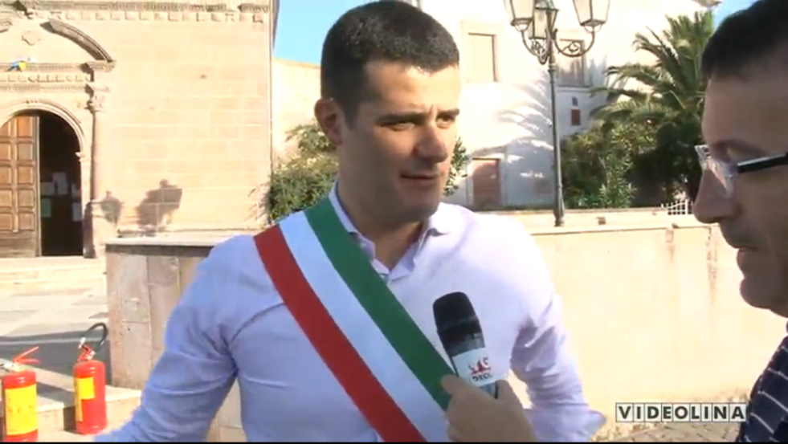
Youth Policy
Smoke signals
1ST act was an intergenerational movement in the town against digital divide.
Smoke signals were used to communicate outside the town with a viral marketing strategy that brought the message outside Sardinia and even outside Italy.

Slide 4
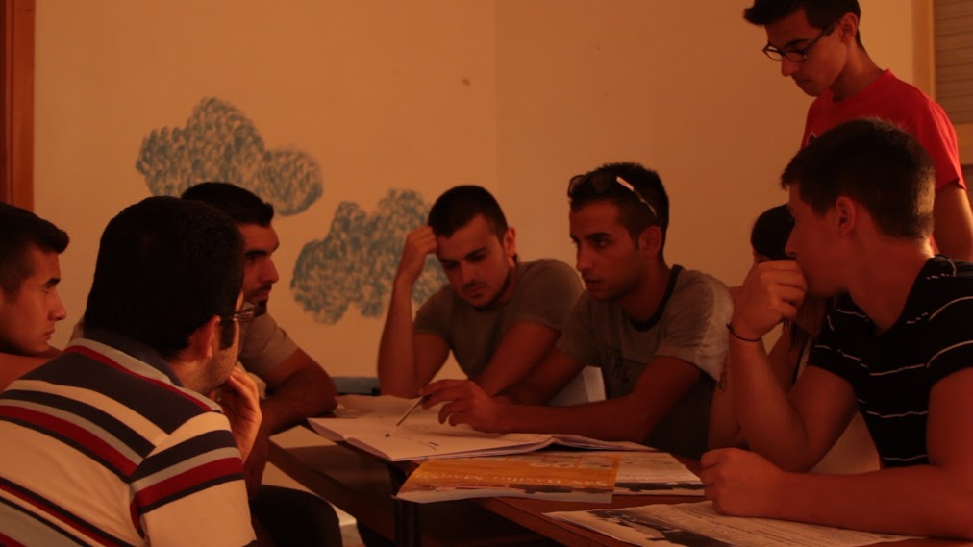
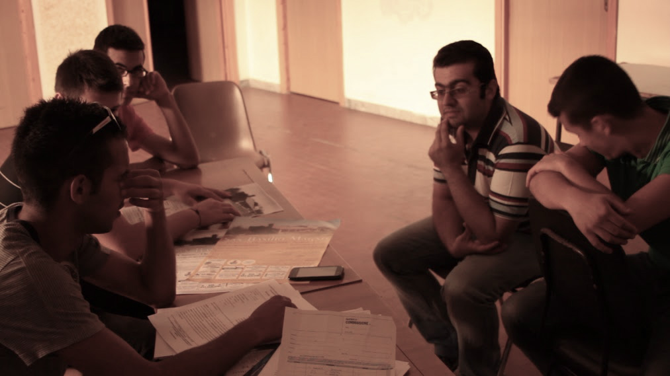
Youth Policy
Youth council
After material infrastructure, the focus of administration went to the human resources, in particular to the youngsters.
With the great efforts of Francesco Spiga, Councilor for Youth Policy, it was found the Youth Council of Nughedu Santa Vittoria;
You already met some of them in Bulgaria on Summer.
Main objectives:
To cooperate with the Municipality for all the activities concerning young people;
To build a political school to teach young people to take their destiny in their own hands.

Slide 5
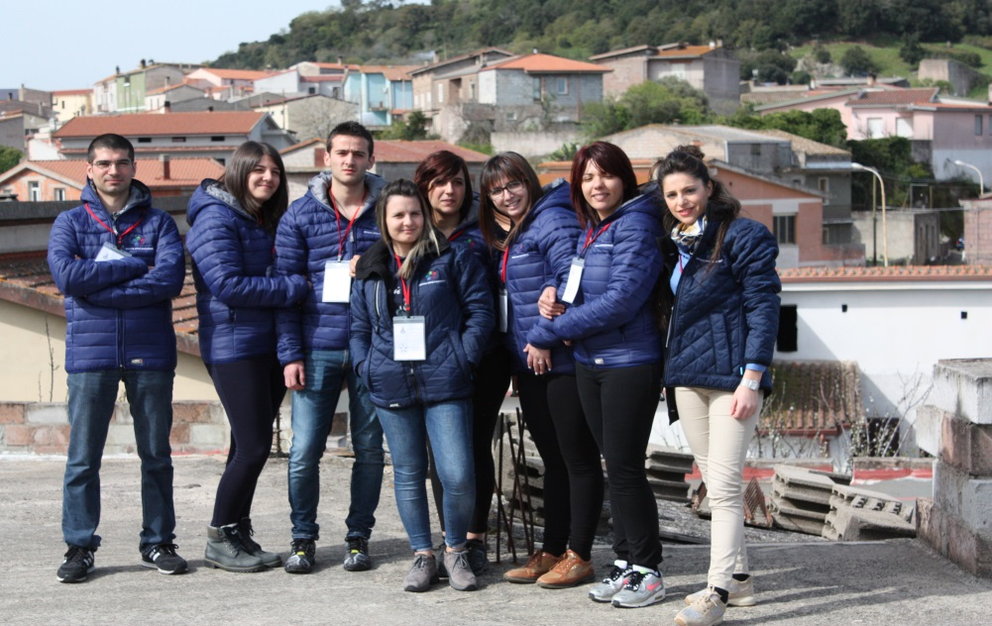
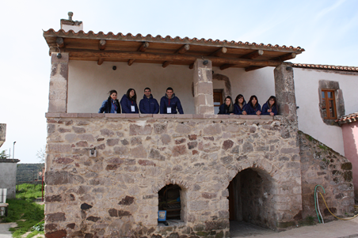
Youth Policy
Civic Service
Legally based Voluntary activities for people between 19 and 29 years;
Founded by Italian State, to replace the military service.
Municipality of Nughedu won 2 projects (Regional Tender) with 4 volunteers each one:
The first project is based on the will to create or better re-create, a special feeling between youngsters and old people of the town (It had very good results);
The second project sees the volunteers constantly update the civil protection plan, in particular hydrogeological risk and fire risk.

Slide 6
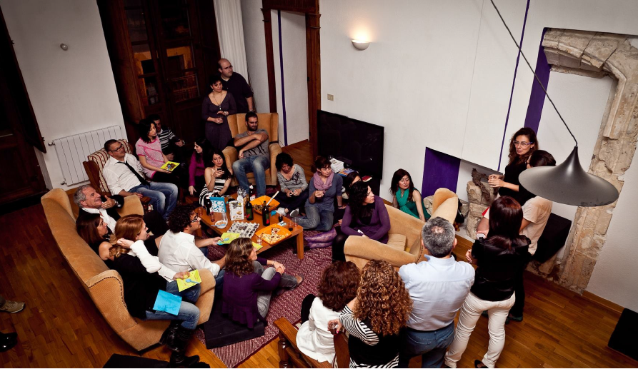
Youth Policy
Welcome Nughedu and social Eating
Widespread accommodation (b&b, private houses)
Social eating: 7 Cooks will open their houses, through the use of an app called Gnammo , to friends and tourist were people can socialize and, above all, to discover the real local food tradition.
The role of the youngsters?
They are the bridge between the old rural world and the globalized one.

Slide 7
Youth Policy
Town Twinning
Great chance, particularly for the youngsters, to feel part of Europe and to become citizens of the future United States of Europe!
As Union of Municipalities of Barigadu we have earmarked significant sums for the creation of Euro-point, to build up new projects and new networks, hoping to find other perfect partners as you!

Slide 8
Thank you

